Slide 1


Slide 2

IMPACT WEAPONS
Instructor:
Date:

Slide 3
OBJECTIVES
Topic: Impact Weapons
Objectives: (Classroom)
  Basic Baton Nomenclature
  Advantages
  Baton Use
  Force Options Context of Impact Weapons
  Primary target Areas for striking

Slide 4
OBJECTIVES
Topic: Impact Weapons
Objectives: (Practical)
  Primary objective of a baton
  Identify deadly force targets
  Medical Considerations
  Baton techniques
  Baton retention

Slide 5
OBJECTIVES
Method Of Instruction: Lecture development, practical application, written exam
Training Aides: Batons, strike shields, foam batons
Pen and paper are required

Slide 6
Introduction
  The baton is designed as an impact weapon that can increase an officer’s safety and temporarily incapacitate a high-level resistant subject.
  The baton is not designed to “inflict punishment”, or cause permanent injury, unless the officer faces threats of grievous bodily harm or death
  Baton is an intermediate force option that works on a scale based on the level of resistance presented by the offender.

Slide 7
Our System
We use a basic baton system to ensure all officers are trained to an equal level. It includes:
  Consistent application
  Professional and controlled conduct
  Trained response vs. panic
  Tactically, legally and medically acceptable

Slide 8
Our System
Components Emphasized:
  Minimal threat to the officer
  Initiate a reactionary gap
  Delivery of strikes with maximum power when appropriate
  Motor points vs. Joints
Minimize Threats:
  Change the line of aggression
  Avoid meeting force head on
  Dynamic Movement

Slide 9
Baton Characteristics
Available in various lenghts, most common are 16, 21 and 26 inches
Consists of telescoping tubes held open by frictions locks through centrifugal force.
Opens by extension of arm and flicking of wrist
Close baton with a sharp tap to a hard surface – do not be gentle

Slide 10
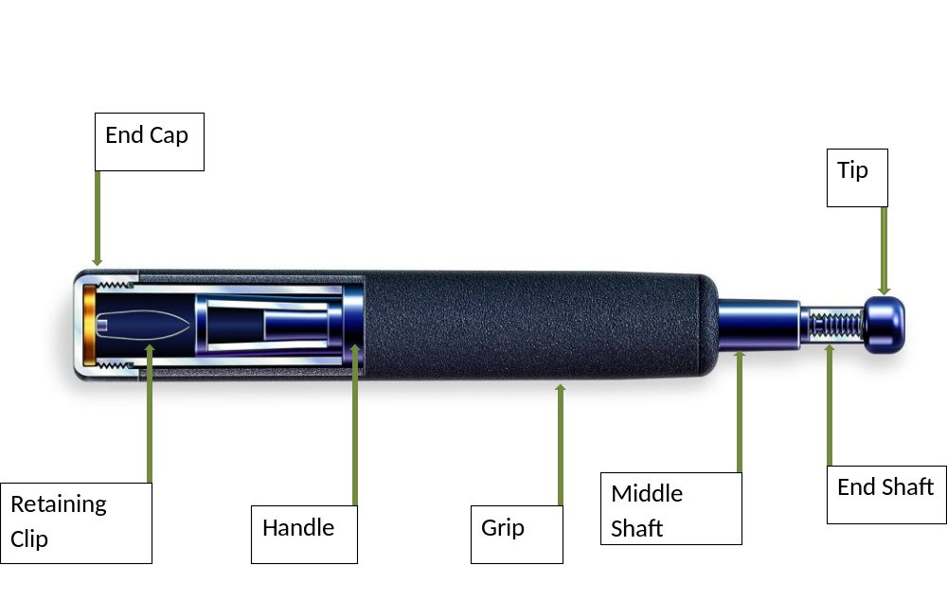
Nomenclature

Slide 11
Advantages
Concealable, both uniformed and LPO
Always with the officer
Low Maintenance
Greater striking force produced than striking techniques
Noise of opening – psychological
Can be used in open & closed modes

Slide 12
Disadvantages
Will not open or stay open if not maintained
Officer Presence minimized

Slide 13
Reasons for Baton Use
Batons provide a distance advantage
Expandable batons extend reach
Striking with a baton reduces potential injury to the officer
Batons increase striking power of officer and target selection is better

Slide 14
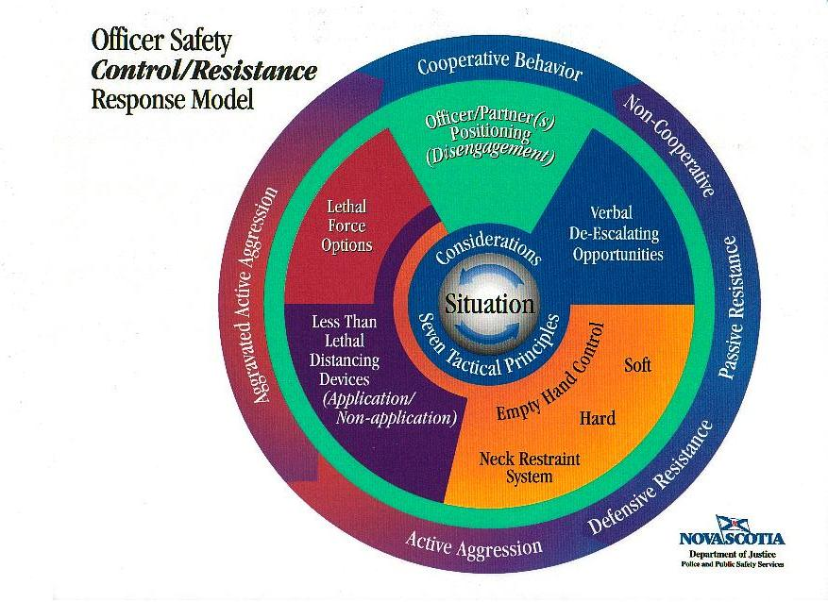
Use Of Force Context
Impact Weapons

Slide 15
Use Of Force Context
Used as a multiples level compliance tool (open / closed / low / high levels of resistance) intermediate weapon
Used on a scale of escalation determined by subject resistance
Fits between empty hand control tactics and firearms
Should only be used when:
  Lower levels of force are ineffective or inappropriate and the use of high levels of force are not justified or appropriate

Slide 16
Scale Of Escalation
There are 4 levels of Escalation
Implied
Motor disfunction / brusing
Baton Contact with bones
Deadly force targets

Slide 17
Scale Of Escalation
Implied
  Components of presence, verbal and non-verbal dialogue

Slide 18
Scale Of Escalation
Motor dysfunction / bruising
  Fluid Shockwave principle
  Primary objective of baton: create motor dysfunction to gain control over resistive subject
  Nerve Motor Points
Expected Effects:
  Motor dysfunction
  Mental Stunning
  High levels of pain
  Balance Displacement

Slide 19
Scale Of Escalation
Baton Contact with bones – joints / breaking
  Higher escalation of force
May Include:
  Hands
  Wrist
  Elbow
  Knee
  Shin
  Ankle
  Foot

Slide 20
Scale Of Escalation
Baton Contact with bones – joints / breaking
Medical Consideration
  High Potential for injury
  Breaking bones
  Soft tissue damage
  Connective tissue damage

Slide 21
Scale Of Escalation
Deadly force targets (areas to avoid unless you are justified in using Lethal Force
    Spine
    Neck
    Abdomen
    Clavicle
    Kidneys
    On
    Throat
    Head
    And
    Testicles

Slide 22
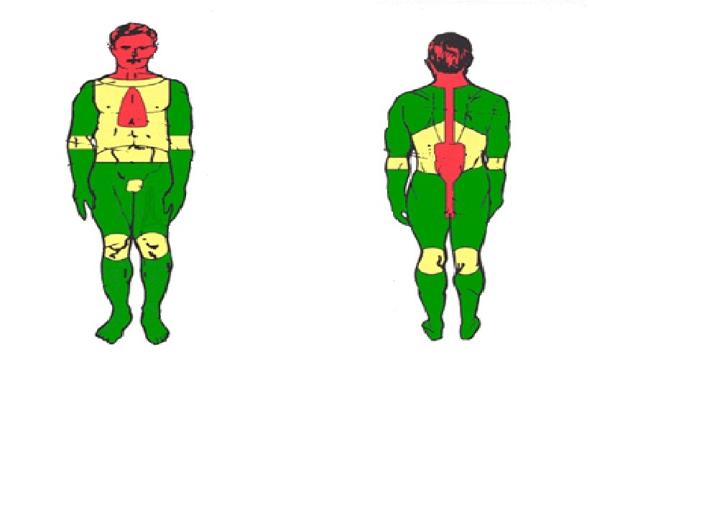
Scale Of Escalation

Slide 23
Scale Of Escalation
Deadly force targets (areas to avoid unless you are justified in using Lethal Force
  Medical Considerations:
    High probability of causing death or serious bodily harm

Slide 24
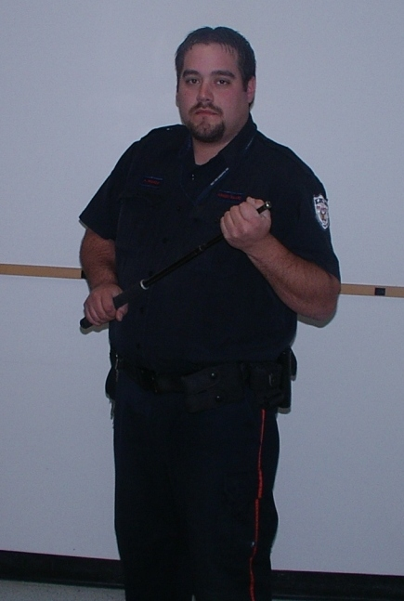
Stances
High Profile Stance

Slide 25
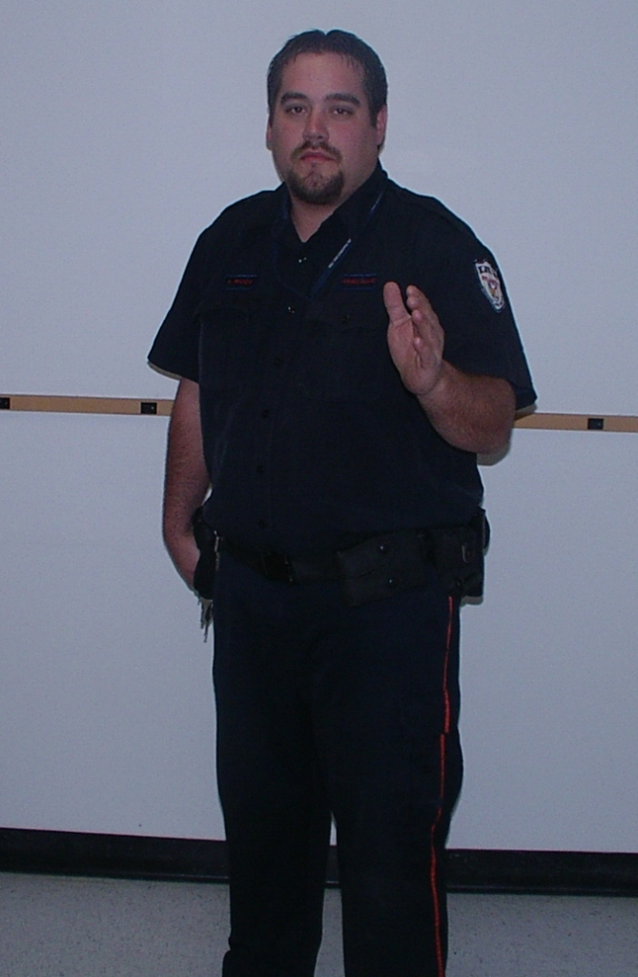
Stances
Low Profile Stance

Slide 26
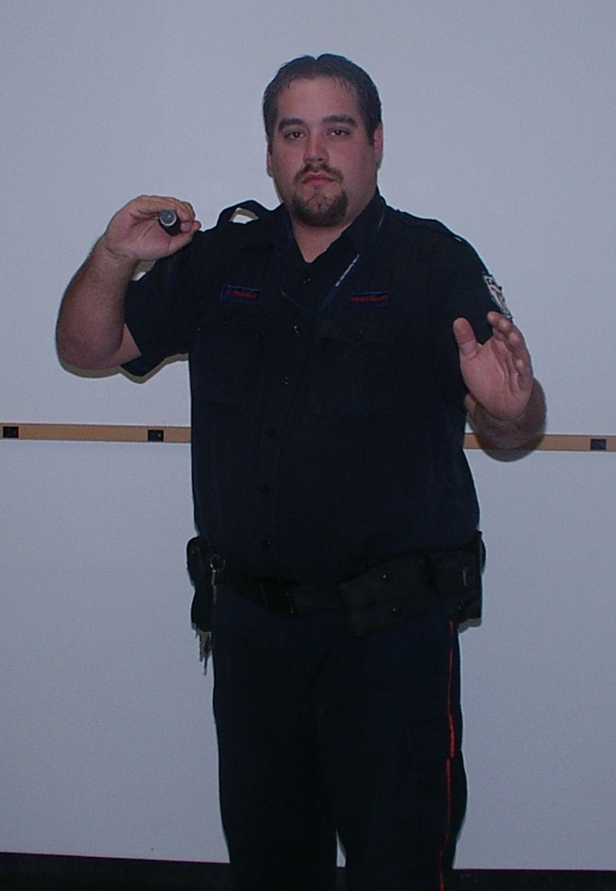
Stances
PPCT Ready Stance

Slide 27
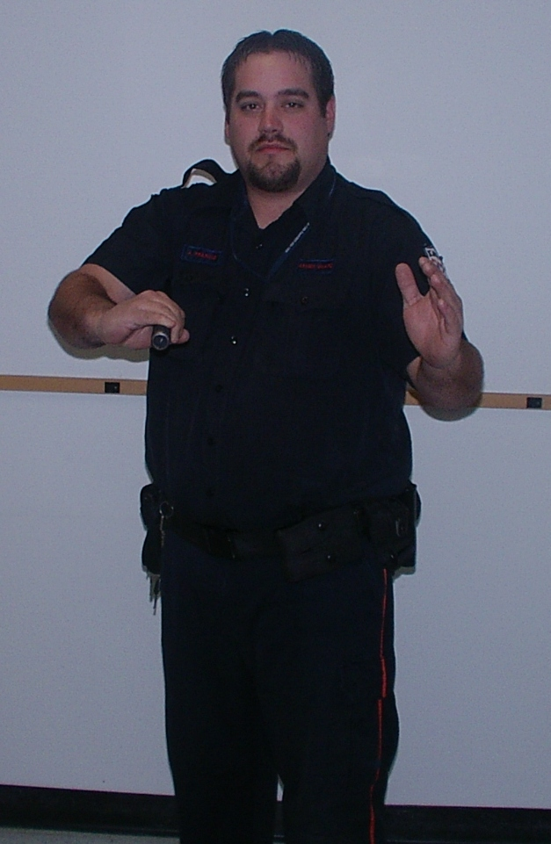
Stances
Spring Loaded Stance

Slide 28
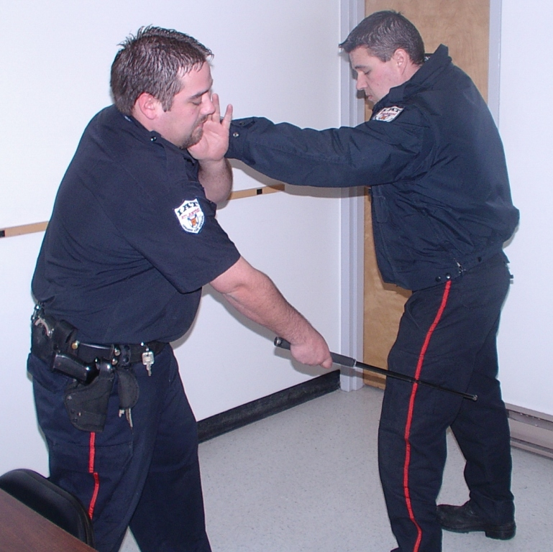
Strikes
Forward Fluid Shockwave Strike (remain on target for ¾ second)

Slide 29
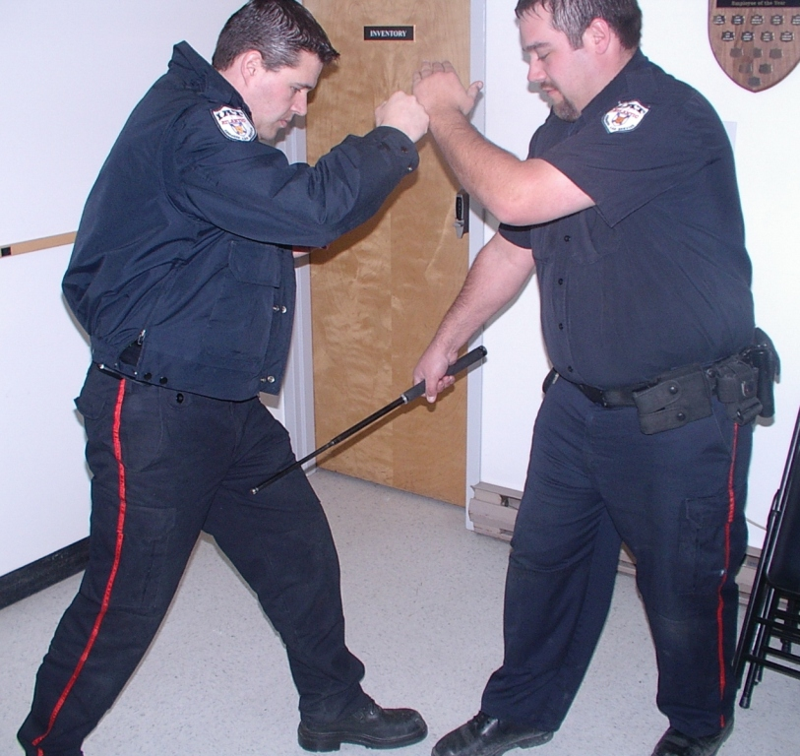
Strikes
Backhand Cutting Strike

Slide 30
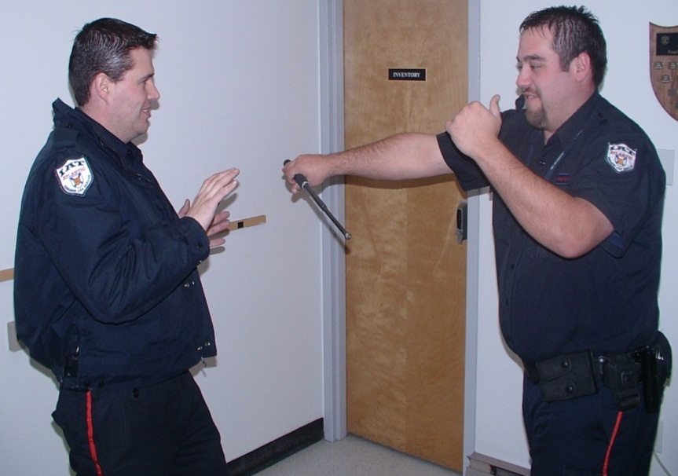
Strikes
Spring Loaded Strike

Slide 31
Striking Points
We have 5 primary striking points:
  Middle of outer thigh
  Middle of inner thigh
  Middle of calf muscle
  Middle of inner forearm
  Upper outer forearm

Slide 32
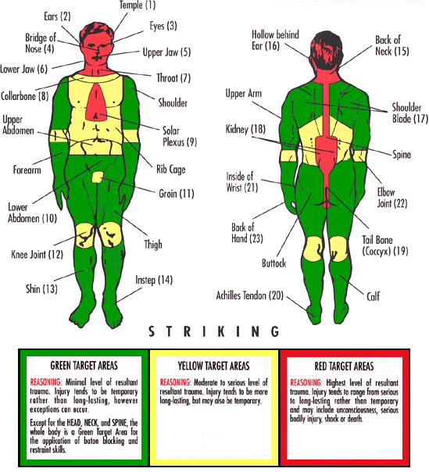
Striking Points

Slide 33
Baton : Summary
We have learned:
  Baton Nomenclature
  Advantages / disadvantages
  Medical considerations
  Scale of escalation
  Stances
  Strikes
  Targets

